Slide 1
Unit 2 IP - Course
(Name)

Slide 2
Agenda
Scenario
In the interview for the chief information officer (CIO) position, you did exceptionally well and were hired by St. Augustine's Hospital. In a staff meeting, you were asked to give a presentation to other employees with the hope of getting volunteers to work with you in setting up the new healthcare IT department.

Slide 3
Explain the impact of the American Recovery and Reinvestment Act (ARRA).

Slide 4
Discuss the Healthcare Information Technology and Economic and Clinical Healthcare (HITECH) Act.

Slide 5
Discuss the impact of the Healthcare Insurance Portability and Accountability Act (HIPAA) on the implementation.

Slide 6
Discuss the threats to the implementation and use of healthcare information systems (healthcare IT), as well as how these threats can be overcome.

Slide 7
Explain what happens if these threats are not alleviated.

Slide 8
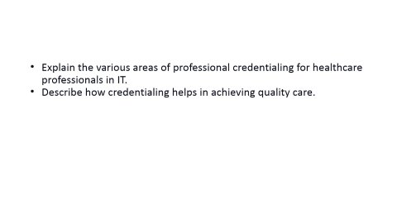
Explain the various areas of professional credentialing for healthcare professionals in IT.
Describe how credentialing helps in achieving quality care.

Slide 9
Describe professional credentialing.

Slide 10
Discuss the importance of credentialing to health IT professionals.

Slide 11
Describe how credentialing helps in achieving quality care.

Slide 12
Explain the benefits of having a healthcare IT department at St. Augustine's Hospital.

Slide 13
Recommendations

Slide 14
Conclusion/Summary

Slide 15
References

